Slide 1
WPI Workday UX
Group 3: Austin, Kushal, Katherine, Joseph

Slide 2
Table of contents
Best Web Practices Critique
User Research
Personas
Empathy and Journey Maps
Survey Results and User feedback
Process Maps
Behavioral Studies
Academic or Industry Journals
Wireframing
Interface Flow Diagrams
Accessibility And Universal Design
Art and Design Theory and Terminology

Slide 3
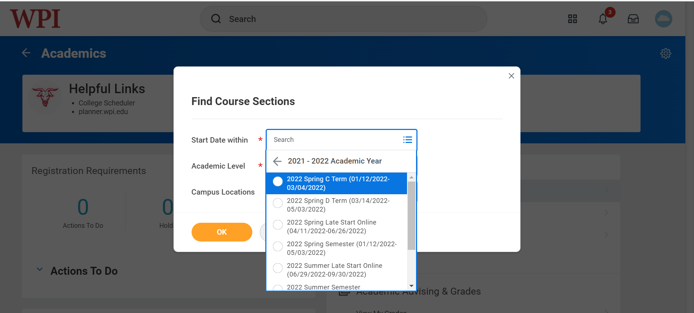
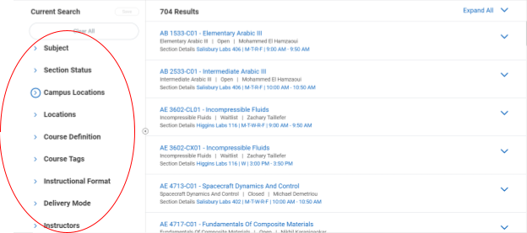
Best Web Practices Critique:
Simplicity

Slide 4
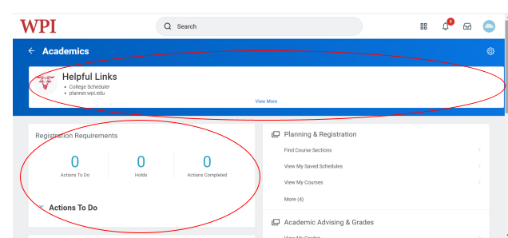
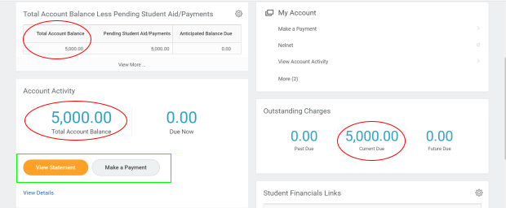
Best Web Practices Critique:
Visual Hierarchy

Slide 5
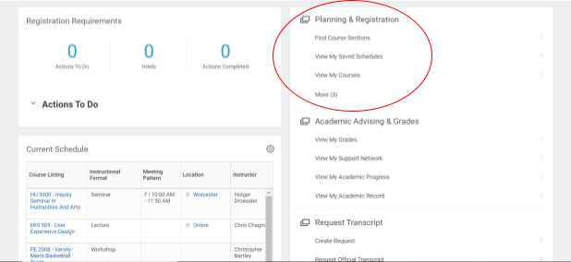
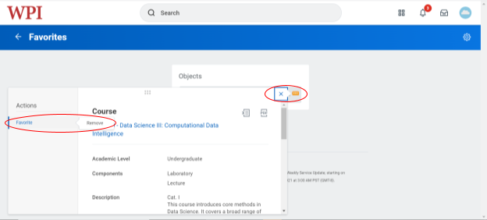
Best Web Practices Critique: Accessibility

Slide 6
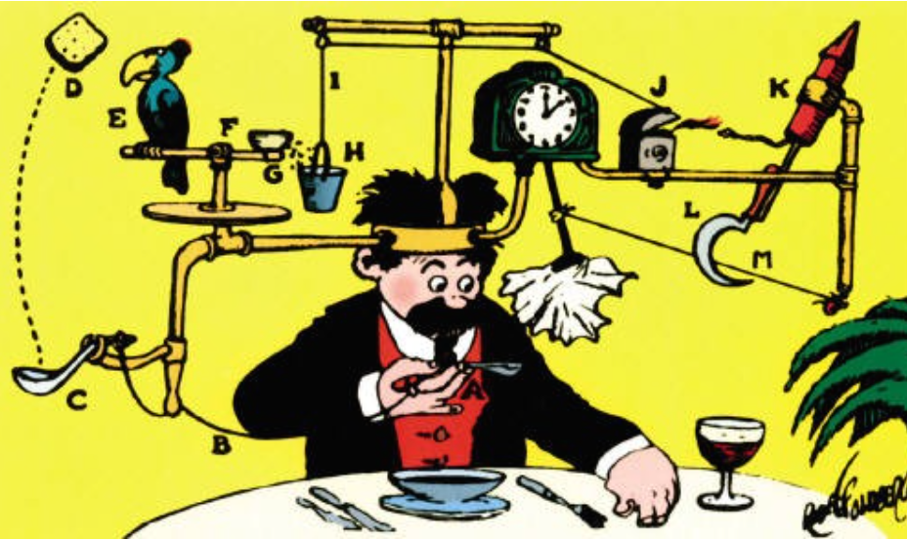
Best Web Practices Critique: User Centricity

Slide 7


User Research: Personas
Persona 1: Alex
Persona 2: Melissa
First Year Student with an Undecided Major
Needs:
Find and register for classes of interest to help decide on major
Find and register for necessary general education classes
Ensure financials are all set
Frustrations:
Difficult website navigation and unnecessary filters / buttons
Course selection menu is too specific about unnecessary things
Unclear how to create and register for a new schedule
Individually clicking through each course to register is time consuming
Senior Majoring in Mechanical Engineering, Minoring in Business
Needs:
Track academic progress to ensure she is meeting all the requirements to graduate
Find and register for specific classes to fulfill major
Easily find important status updates in the inbox
Frustrations:
Difficult website navigation and unnecessary filters / buttons
Poor academic progress tracking
Having messages show up on homepage feels like a lack of privacy
Notes:
To truly get a feel for the user experience of Workday for different students, the team created two persona’s so we could view the website through their eyes. Given where they are in their college journey, each persona has different needs and frustrations related to what they rely on workday for.

Slide 8
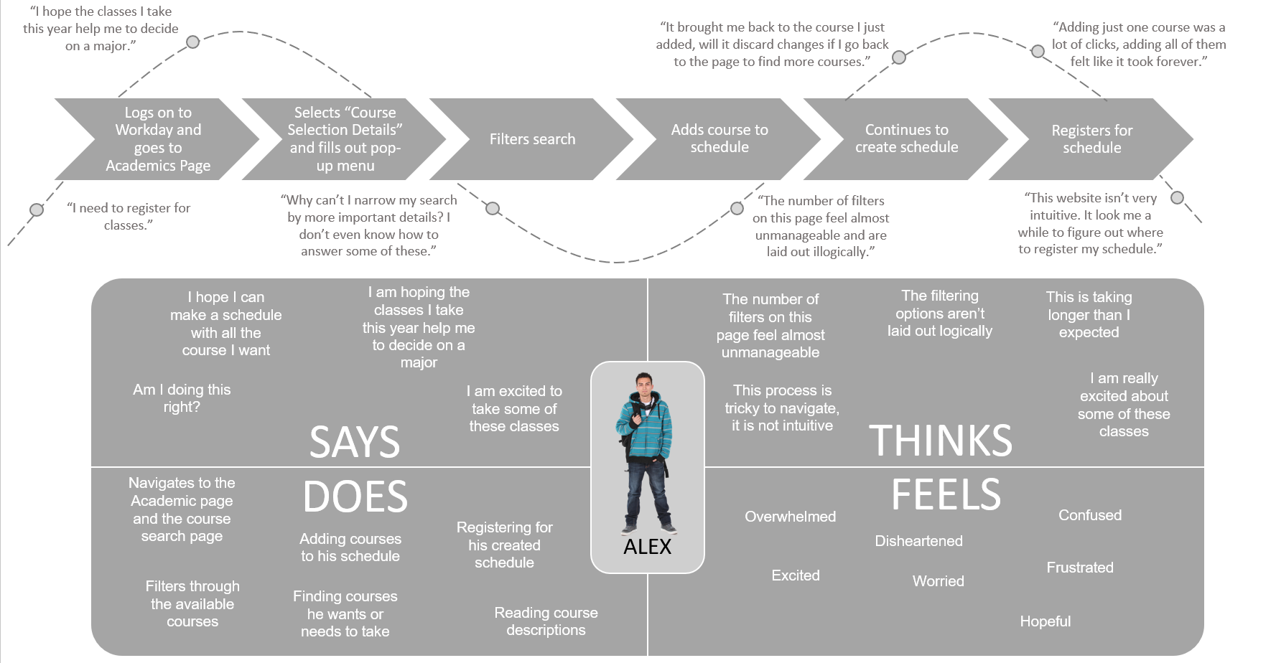
User Research: Journey and Empathy Maps for Course Registration
Notes:
Through our research and own experiences, the team found that the process of searching, scheduling, and registering for courses to be particularly frustrating. We created journey and empathy maps for one of our personas going through this process. This allowed us to pinpoint where to focus on potential improvements.

Slide 9
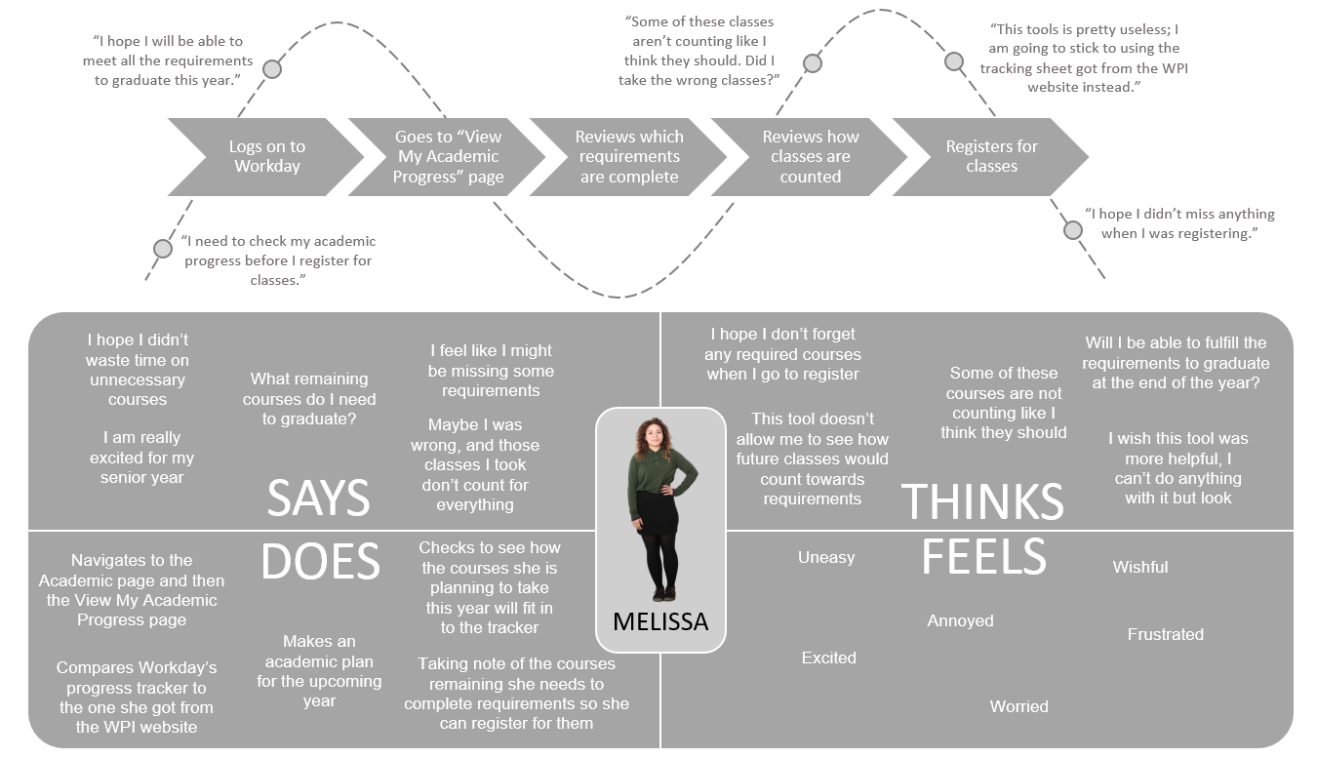
User Research: Journey and Empathy Maps for Academic Progress Tracking
Notes:
Similarly, the team created journey and empathy maps for persona two when checking her academic status. Again, this highlighted where the user experience needed to be improve.

Slide 10
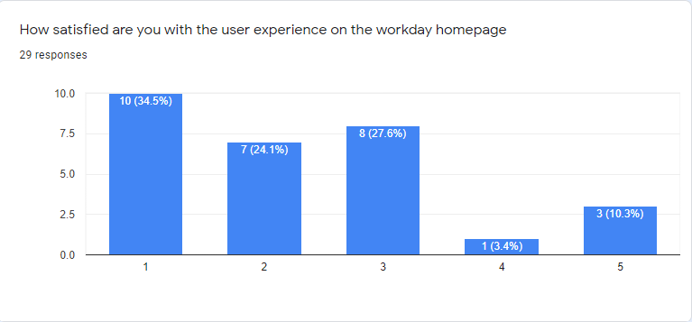
User Research: Surveys and Feedback
The process to do anything is too long
It’s not that simplified
Poor layout
Workday feels like it was designed by someone who has never used a website before
nothing is straightforward
GUI is slow
Lack of accessibility and unintuitive menus
TOO MANY USELESS BUTTONS
It tries so hard to be fluid but it just isn't its very choppy and goes against the golden rule of UX design that everything should be one click away from the home screen

Slide 11
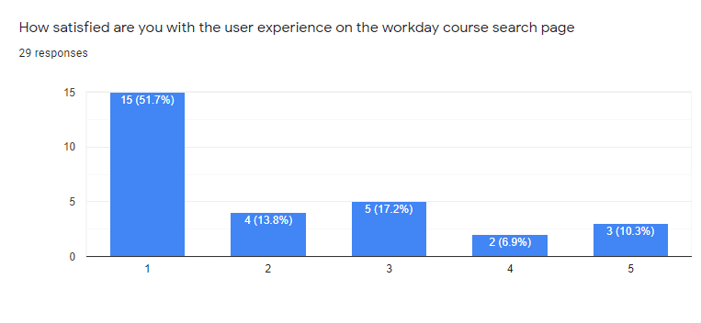
User Research: Surveys and Feedback
Just find it hard to change search parameters.
Some of the classes listed from the search aren’t actually available.
I have to select a term, cannot select multiple
Annoying to go back a page
It makes no sense it is a financial app that happens to search courses
You have to choose a term before searching classes (rather than seeing all terms it is available, even for just two terms)
shows every section and so many clicks
There are SO many buttons to get to what you want
Courses are hard to find and register
cant see all the sections neatly
it doesn't actually iterate through any of the desired features of the site

Slide 12
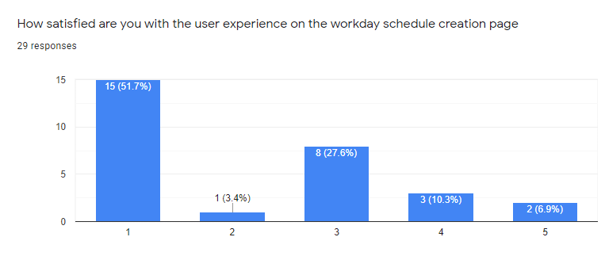
User Research: Surveys and Feedback
it's kinda slow and isn't really that easy to use
They combine both terms onto one calendar
Why does it let me display my schedule as a pie chart. WHAT!?
It?? Makes?? No?? Sense??
its too complicated
Everything requires way too many steps and things aren't well labeled
Cant even use the calendar or calendar mixes terms together
The process is not efficient, grouped courses are not indicated at all
it is nothing compared to the planner we used to have. having dropdowns as selections for classes is horrible design
The way the schedule looks - just a list is not the best way to represent it

Slide 13
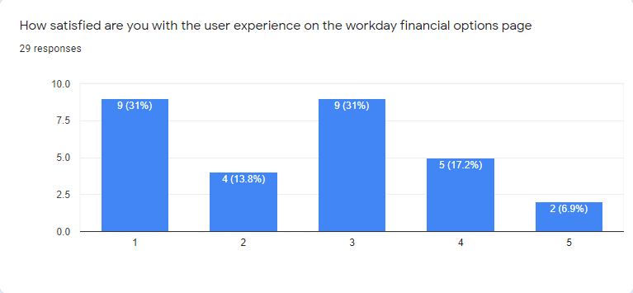
User Research: Surveys and Feedback
The whole process is confusing and complicated, which makes people worry about if payments go through and what charges are made
Confusing statements
It makes no sense
It sucks
Half of it students don't use and none of it makes sense
Data inconsistent and incorrect
Confusing layout
Again, good design is simple design. Things should be 1 click from the homepage. having popup and redirects just isn't good design

Slide 14
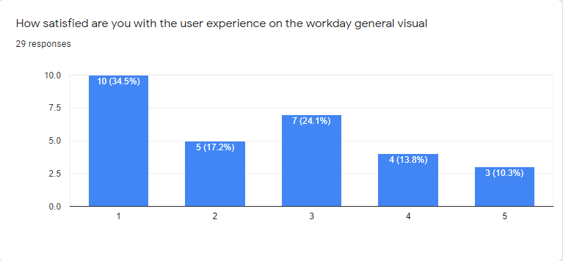
User Research: Surveys and Feedback
Very generic.
Not intuitive
Terms should be separate when viewing calendars
It sucks
it's too confusing
Too many steps
Too much white space
everything is a drop down and it looks super choppy. Just very poor design

Slide 15
User Research: User Feedback
Course selection is complex and difficult
Workday sucks overall. Nothing ever works. Nothing is easy to find. Scheduling through it is always a disaster.
Nothing just make it more simpler and fix the above give points
The course tracker sheet in workday is kinda confusing
Super long time for course registration, lag worse than banner
Wish they had an app (they might not sure)
UX is inconsistent on mobile vs desktop and “Expense” tab isn’t available at all on mobile
Requesting transcripts is confusing
Poor course registration steps
Comparison options PLEASE. WPI planner is an amazing tool and a great reference for the direction workday should take. It's easy to swap between viewing option A with xyz class and option B with xyf class, or shuffle classes around because class is offered A and B term, and it would be really easy to take it B term but I can't see that when just planning A term.
i love workday esp compared to banner web
It all sucks
it's not user friendly
Menus are heavily nested and unnecessarily hidden
PLEASE HAVE COLORED CALENDARS
When I went through the process of setting up my account, I felt like I never knew whether I had actually done everything I needed to. I never used Bannerweb so I have no metric to compare workday to though.
More intuitive UI
I've ran into so many authorization issues with no help offered to try to find what I'm looking for. It's just such a horribly designed website

Slide 16
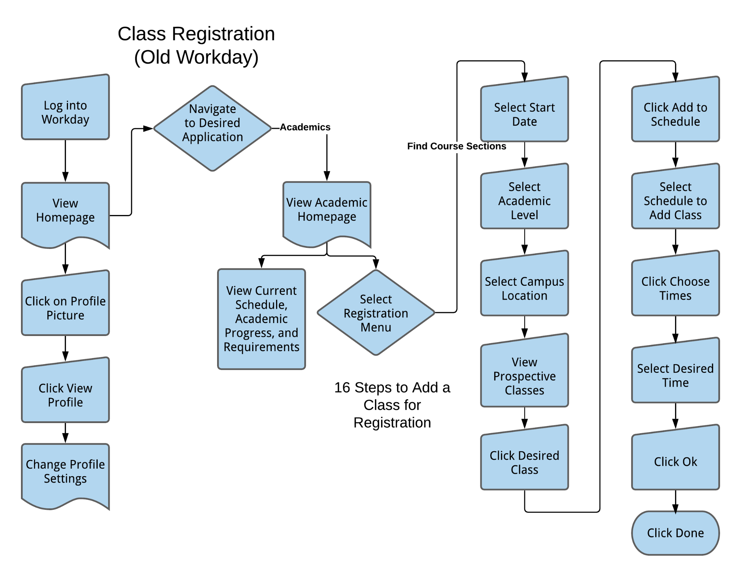
User Research: Process Maps
Notes:
This flowchart shows the process a user would experience when registering for a class. There are many menus and stoppage points that create extra steps for the end user. In total there are 16 steps from login to adding a class to the user’s schedule.

Slide 17
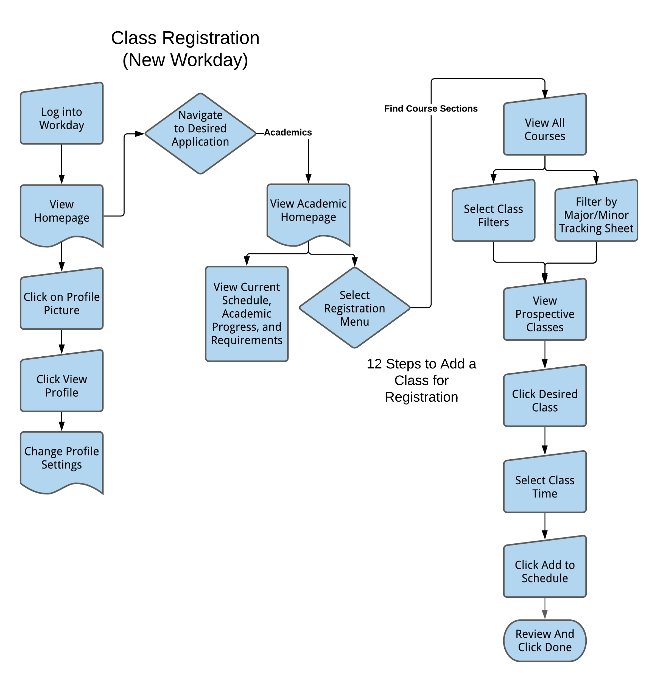
User Research: Process Maps
Notes:
Comparing the previous flowchart to the improved flowchart shows areas where the user experience can be streamlined. By eliminating excessive and repetitive menus, the process to register for a class can become much shorter. With this design, there are 12 steps for the user to go from login to registering for a class.

Slide 18
User Research: Behavioral Studies
Two studies: Elements of Reading Experience and Application of User Behavior Research
The user behavior method is a system and strategic approach involving spatial cognition and spatial behavior planning
Users’ past UX must never be neglected when such a multi-purpose interactive interface is developed for complex reading activities
Guided by the contemporary trend of life, they should introduce as much technology as possible to users' daily life, instead of forcing users to adapt to rigid technology
The designer needs the information task of the application to create an effective system, that focus is to enhance the understanding of information
Positive feedback should be given to the users’ task status and operation

Slide 19
User Research: Academic/Industry Journals
Four studies: User Experience on Small Screens, The Study of Visual Elements Design Based on User Experience, The Five-Second Rules, and Investigating the Quality of Motion in User Interfaces
Homepage design is crucial because it determines how quickly information can be locate
Interactivity should be taken into consideration when designing mobile web interfaces in order to attract new users or retain existing ones
The major findings in both of our studies are that “simpler is better”
Contrast Principle consists of size contrast, brightness contrast, comparison of horizontal and vertical lines, and texture
Main purposes of a home or landing page are generally universal: (a) to give users high-level information about a site and (b) to provide a means of getting to the more specific content areas within the site
When designing for better experiences, it has become important to provide a holistic experience with consideration to emotion

Slide 20
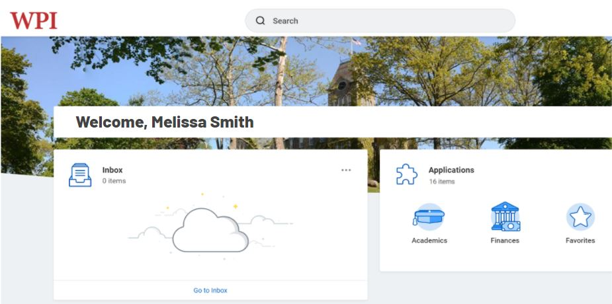
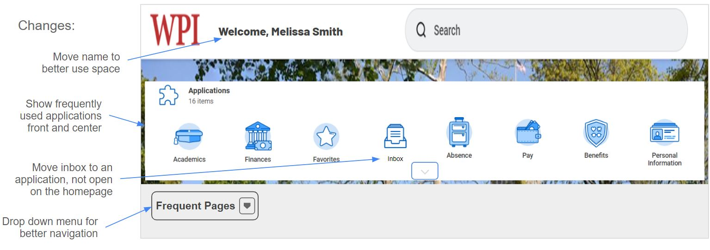
Wireframing: Homepage Updates
Notes:
Combining all of our user research, the team created wire frame versions of how we could update different aspects of work day. here you can see our proposed changes for the homepage.

Slide 21
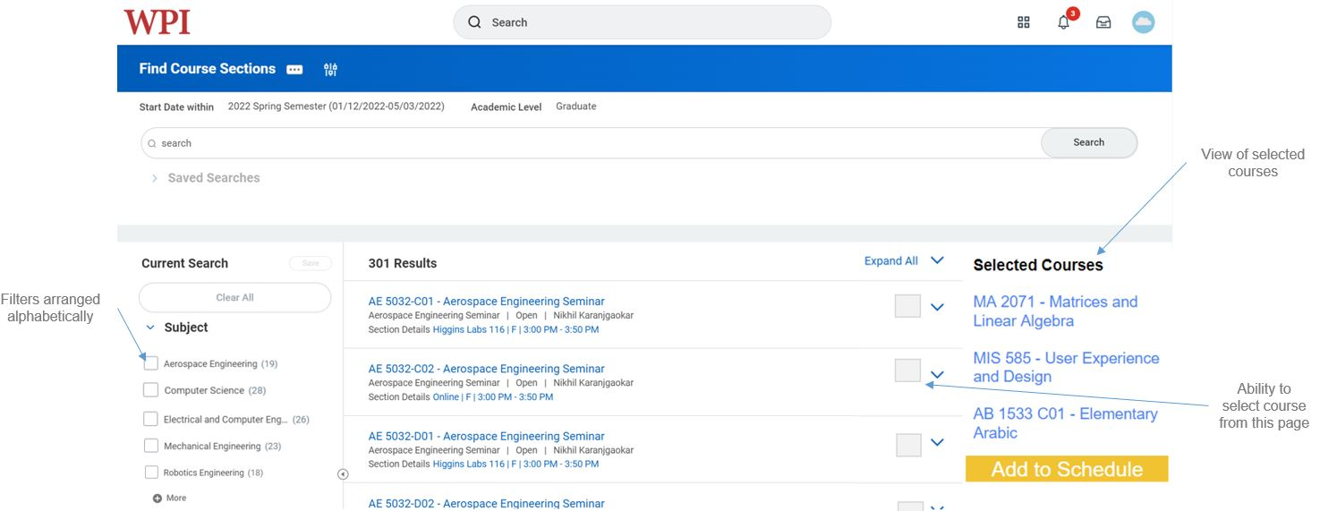
Wireframing: Course Search Page
Notes:
This slide shows how we would update the course search page to streamline the schedule creation process.

Slide 22
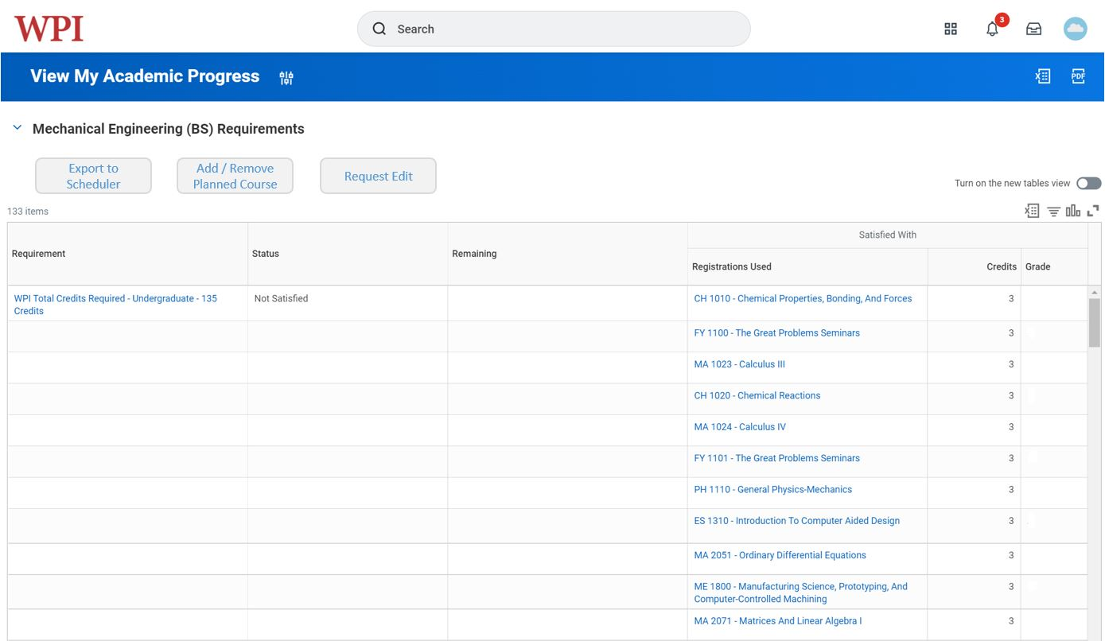
Wireframing: Academic Progress Tracking Page
Notes:
Here is a potential way Workday could add capabilities to the academic progress tracking page to make it more useful for students.

Slide 23
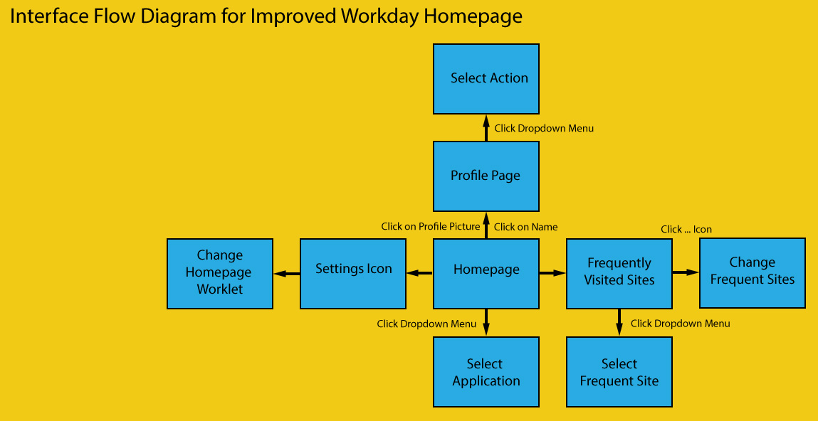
Interface Flow Diagrams
Notes:
This flow diagram shows various interaction points a user would experience directly from the homepage. This flow diagram is designed to allow for maximum navigability with minimal clicks by utilizing dropdown menus directly on the homepage.

Slide 24
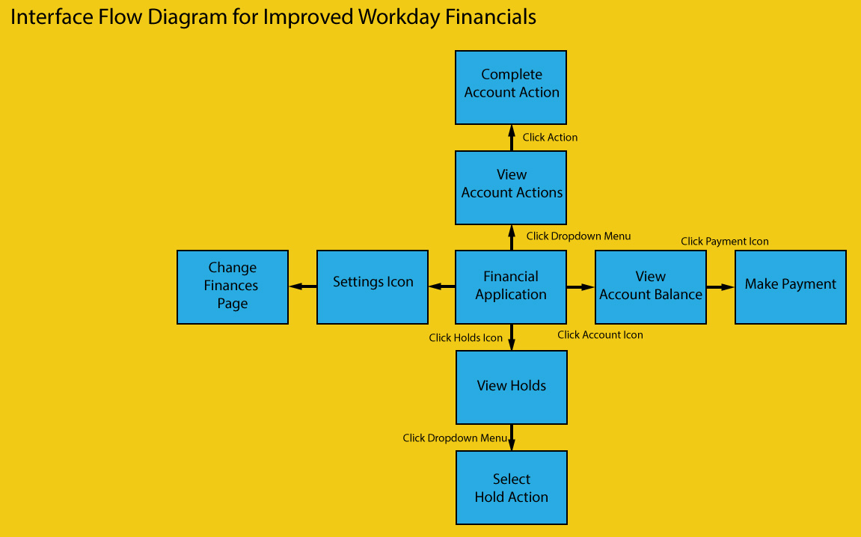
Interface Flow Diagrams
Notes:
This flow diagram shows the various interaction points for a user interacting with the financials page. The most frequent actions are the closest interaction points for the user to allow for maximum convenience

Slide 25
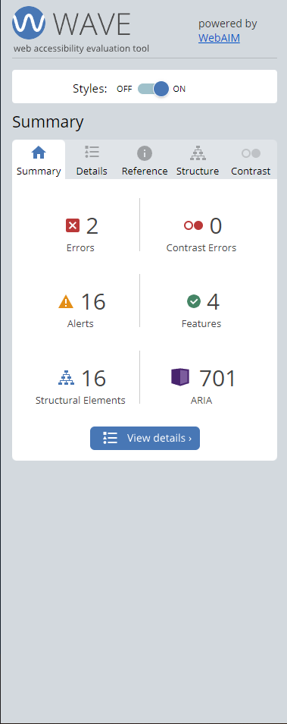
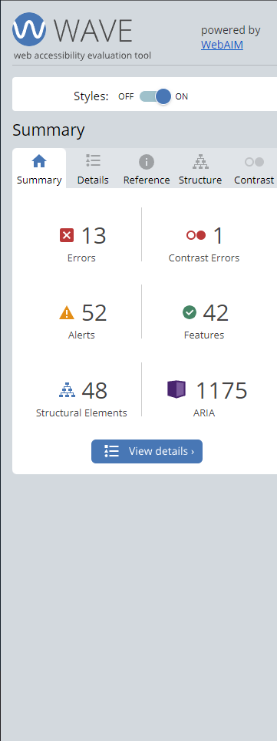
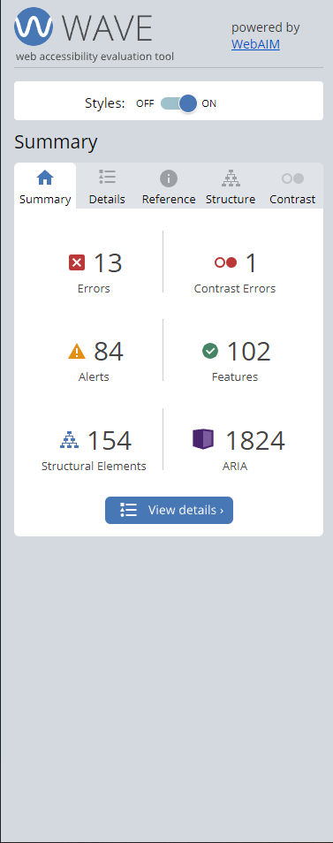
Accessibility and Universal Design
Home page
Finances Page
Academics Page

Slide 26
Art and Design Theory and Terminology
The workday site could have a better User experience by making it more relatable to the WPI students , for example, the concept of similarity. Almost all WPI Sites have a standard red and white design whereas Workday has a Blue design. This leads to the user not understanding at the first glance that the Website is related to WPI due to the Similarity not existing.
While they have used different sizes, the sizes have not been used in a way that would help users understand the importance of one part over the second part as the sizes have not been standardized. They have used a standard shape for all the details which would be great for the user to understand what parts are similar. The buttons being in a different shape brings attention to the fact that they are buttons and hence give the users a better experience. They have the boxes with details separated but the colors are not present to separate the contents of the box from one another. This would lead to an issue for the user to differentiate the contents from one another as there is no color differentiation between them to make it easier. While the White space is used effectively for the users to better help understand the different sections of the site, the proximity is slightly jarring from the Design perspective as the things in proximity would be better of related to one another to help users reach the section of the site they want to interact with on the site faster and easier

Slide 27
Thank You
Austin, Kushal, Katherine, Joseph

